Slide 1
HealthApp
Team 4:
Tarun Dagar
Jigarkumar Patel
Riddhi Mhatre
Vivek Karhale
Sriharsha Mopidevi
Fernando Hernández
Aliaksandra Paliashchuk
Nishith Desai

Slide 2
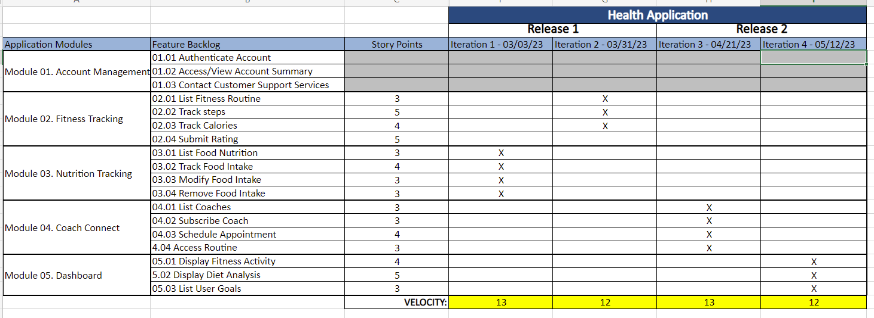
Road MaP– Tarun Dagar

Slide 3
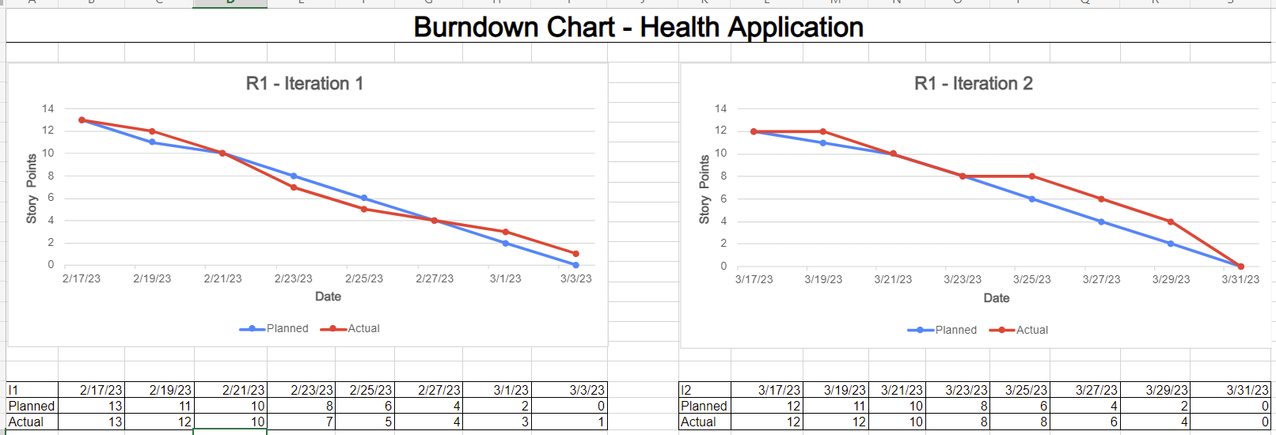
burn down chart - Fernando Hernández

Slide 4
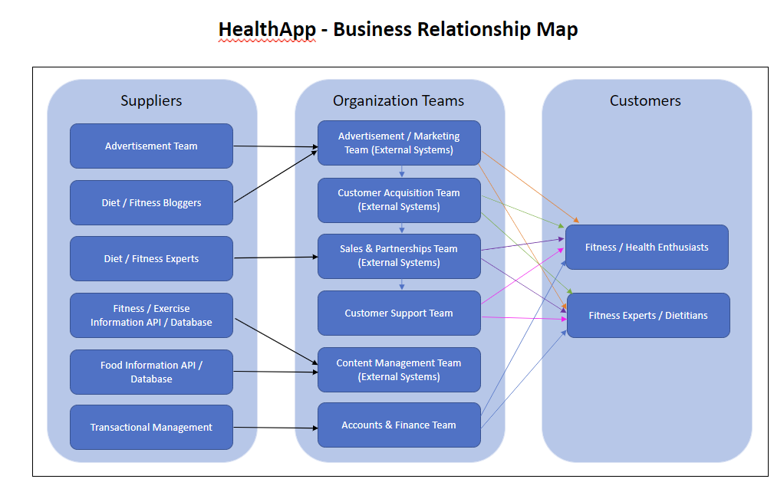
BRM

Slide 5
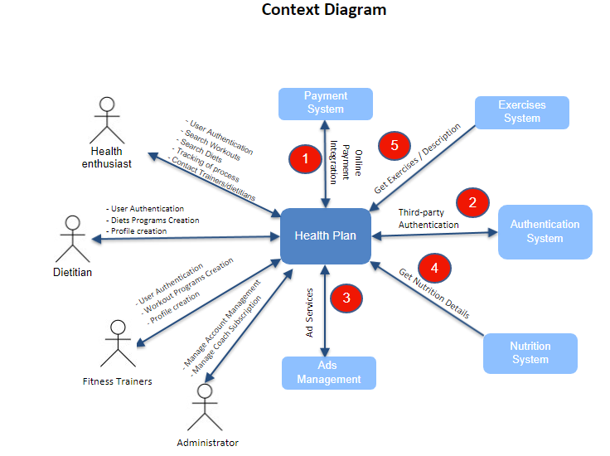
Context_Diagram Jigar

Slide 6
No​ | Description​ | Source​ | Target​ | Frequency​ | Validation​
1​ | Online Payment Integration​ authorizes payments by fetching the credit card details from the bank and sending it to the App​ | Payment System​ | Health Plan​ | Real-time​ | Amount to be charged needs to match​ with amount indicated in monthly service bill ​
2​ | Third-party Authentication gives access to user information to the App via an authentication provider​ | Authentication​ System​ | Health Plan​ | Real-time​ | User's account information to be verified third-party services​
3​ | Ad Services to send and receive ads on the App based on the user information.​ | Ads Management​ | Health Plan​ | Real-time​ | Ads systematically feed while user entering​ website​
4​ | Get Nutrition Details​ | Nutrition System​ | Health Plan​ | Systematic Feed​ | User gets nutrition details for a particular food from external API​
5​ | Get Exercises / Description​ | Exercises System​ | Health Plan​ | Systematic Feed​ | User gets description and instructions on different exercises to do from external API​

Slide 7
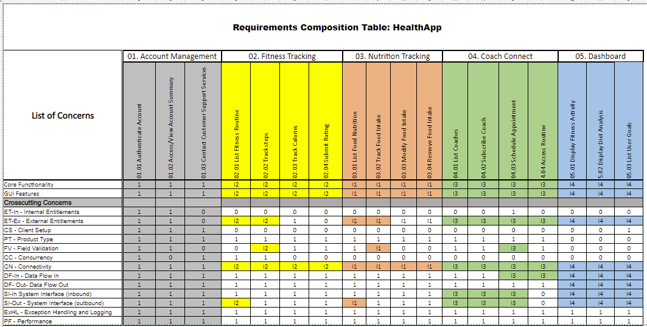
Rct - Aliaksandra Paliashchuk

Slide 8
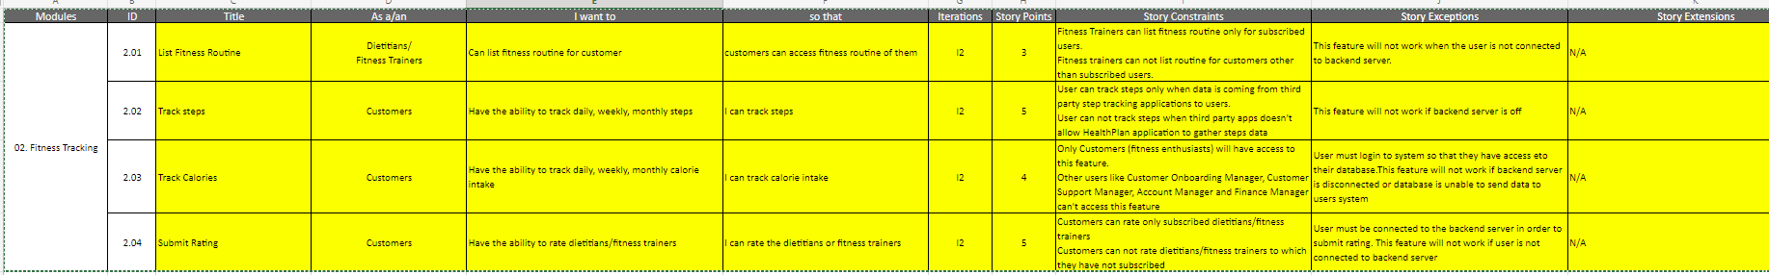
User stories- Vivek
Modules | ID | Title | As a/an | I want to | so that | Iterations | Story Points | Story Constraints | Story Exceptions | Story Extensions
03. Nutrition Tracking | 3.01 | List Food Nutrition | Dietitians/ Fitness Trainers/ Customer Onboarding Manager/ Customer Support Manager | Can list all the foods | I can see food intake and nutritional values of food | I1 | 3 | Only dietitians/fitness trainers can list food nutrition. Customers(fitness enthusiast) can not list it. | This feature will not work when the user is not connected to backend server. | N/A
 | 3.02 | Track Food Intake | Customers | Have the ability to track daily, weekly, monthly food intake | I can track details of food intake | I1 | 4 | This feature will be only available to customers (fitness enthusiast). Other users like Customer Onboarding Manager, Customer Support Manager, Account Manager and Finance Manager can't access this feature | User must login to system so that they have access eto their database.This feature will not work if backend server is disconnected or database is unable to send data to users system | N/A
 | 3.03 | Modify Food Intake | Customers | Have the ability to modify food intake user already entered | I can modify food item as well as quantity of food entered | I1 | 3 | Only Customers (fitness enthusiasts) will have access to this feature. Other users like Customer Onboarding Manager, Customer Support Manager, Account Manager and Finance Manager can't access this feature | User must login to system so that they have access eto their database.This feature will not work if backend server is disconnected or database is unable to send data to users system | N/A
 | 3.04 | Remove Food Intake | Customers | Have the ability to remove food intake | I can delete entry of food item entered | I1 | 3 | Only Customers (fitness enthusiasts) will have access to this feature. Other users like Customer Onboarding Manager, Customer Support Manager, Account Manager and Finance Manager can't access this feature | This feature will not work if backend server is disconnected or database is unable to send data to users system | N/A

Slide 9
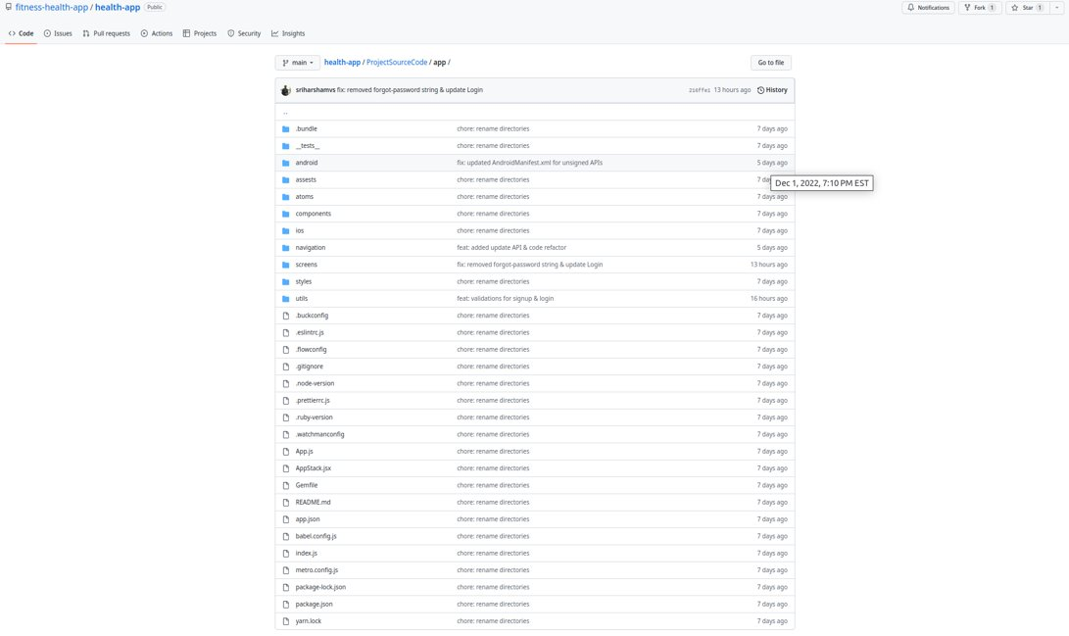
Source Code - Sriharsha Mopidevi

Slide 10
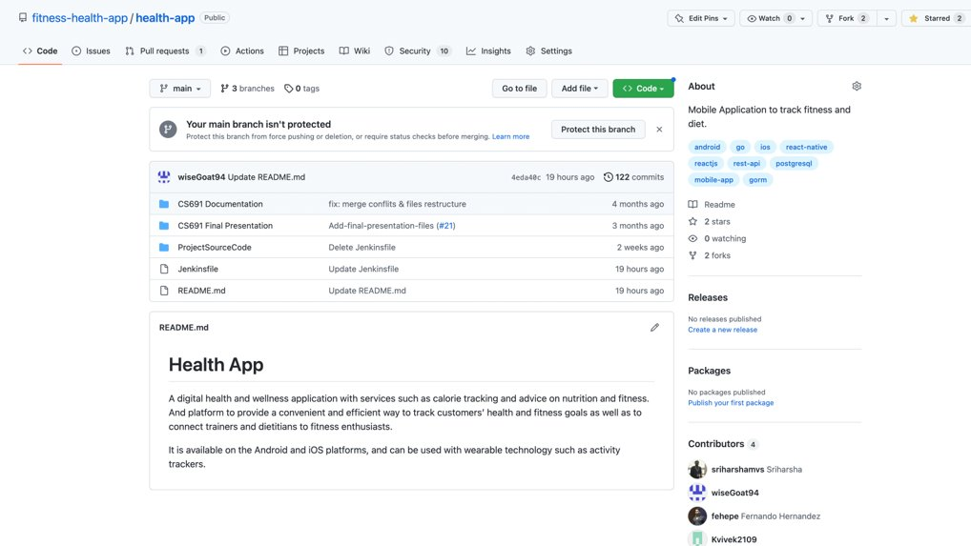
GIThub - Sriharsha Mopidevi

Slide 11
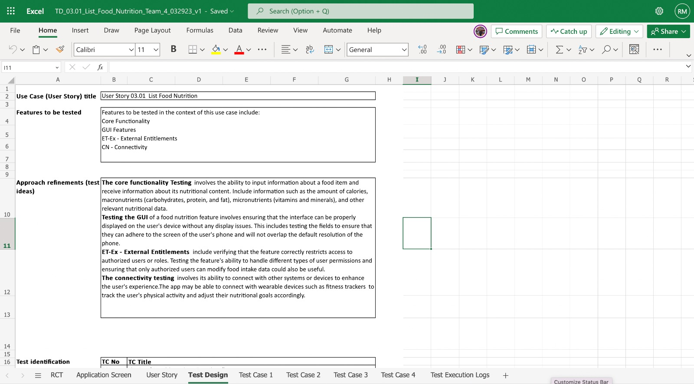
Acceptance Tests i1–Riddhi

Slide 12
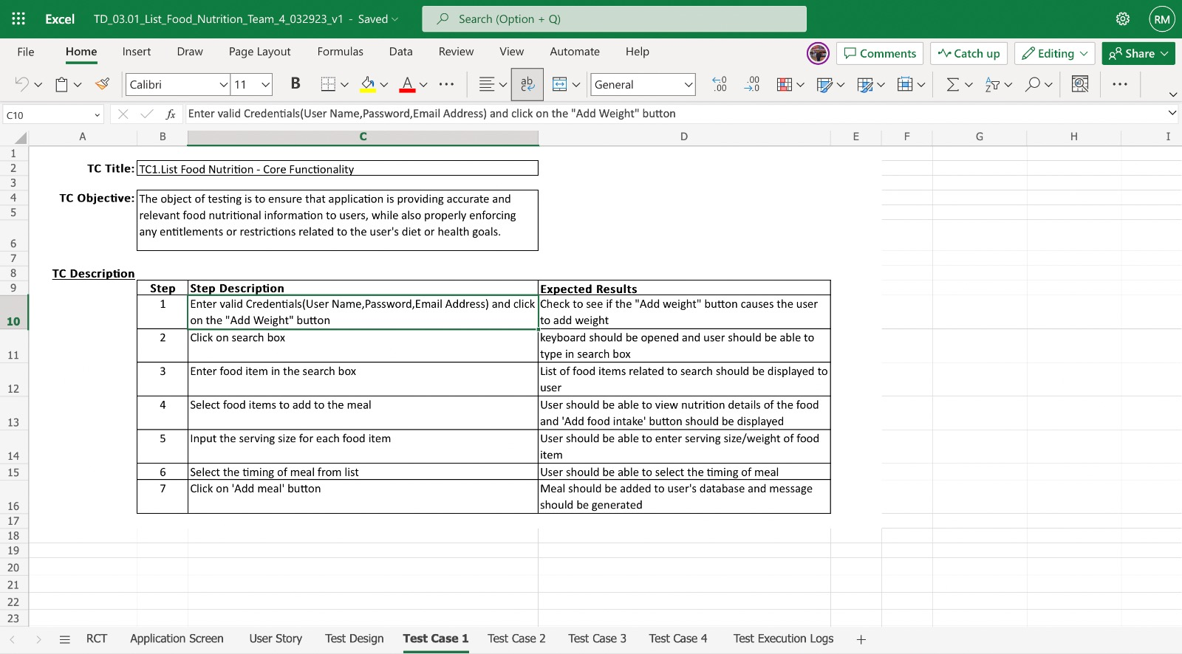

Slide 13
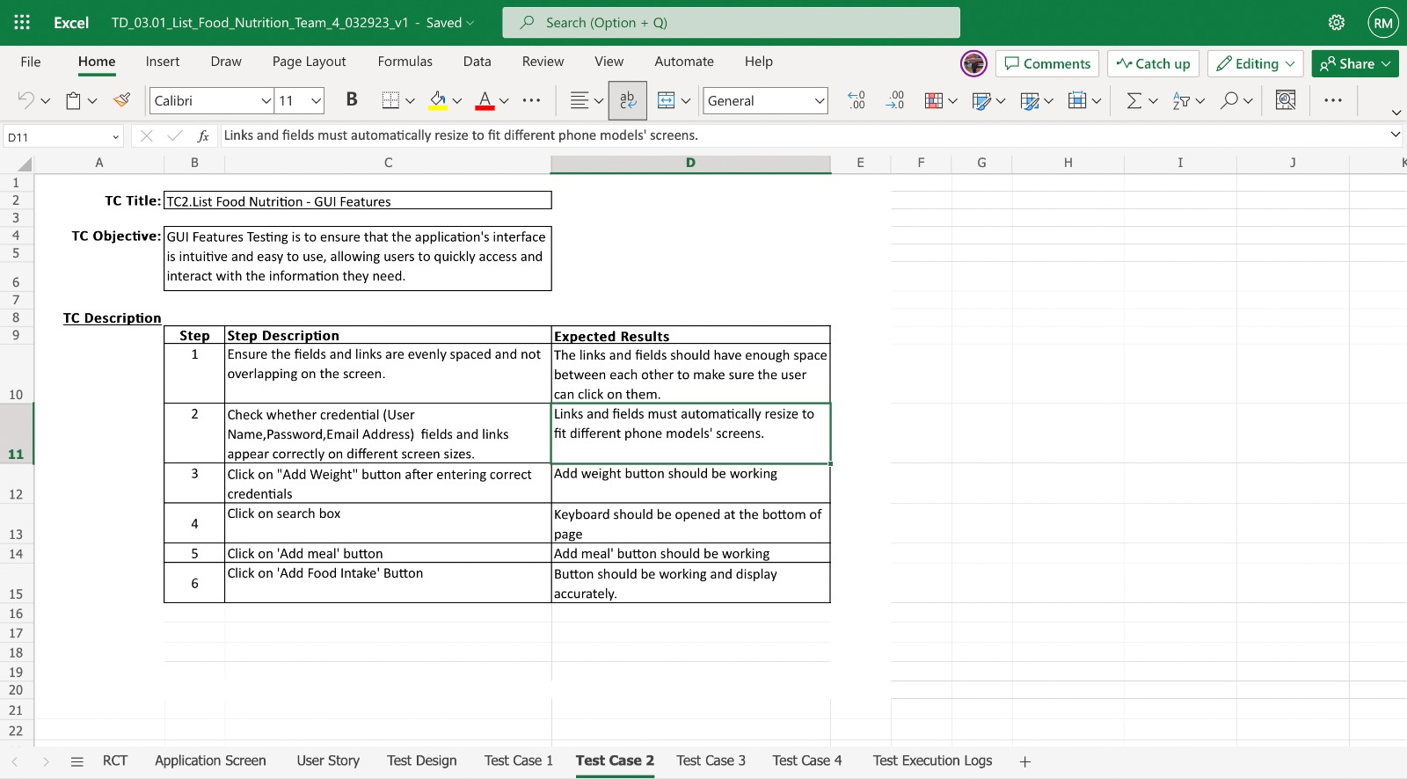

Slide 14
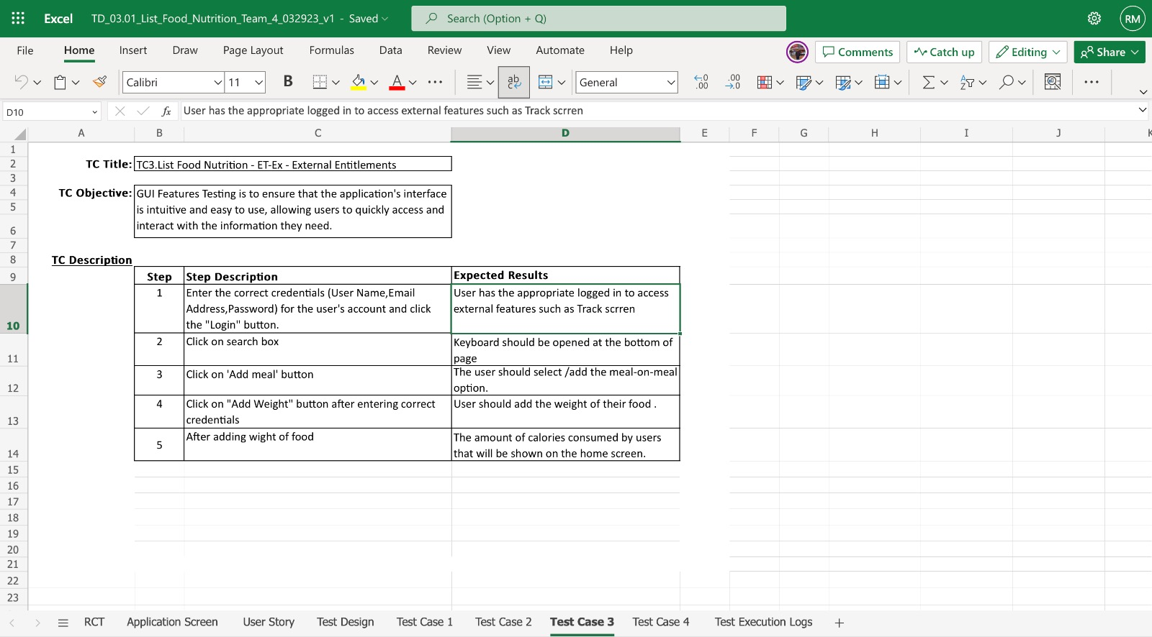

Slide 15
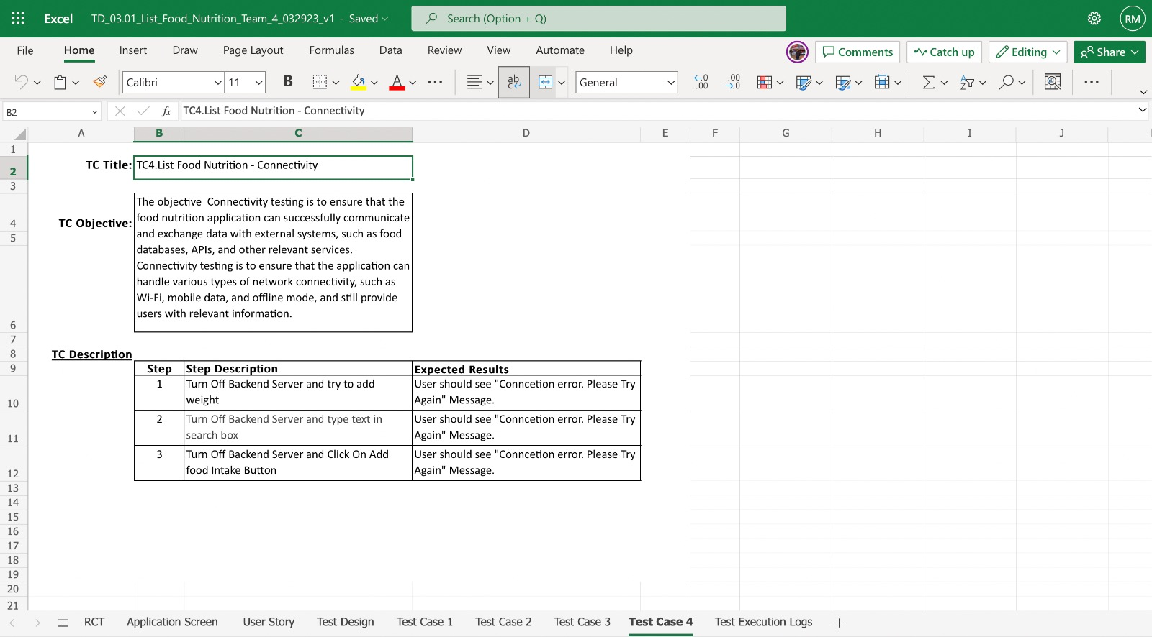

Slide 16
Test Set | Test Case Title | Status | Exec. Date | Tester's Name
Iteration 1 | TC1.Remove Food intake - GUI Features | Run | 3/20/23 | Nishith Desai
Iteration 1 | TC2.Remove Food intake - Core Features | Run | 3/21/23 | Nishith Desai
Iteration 1 | TC3.Remove Food intake - Connectivity | Run | 3/21/2023 | Nishith Desai
Test Set | Test Case Title | Status | Exec. Date | Tester's Name
Iteration 1 | TC1. Track Food intake - GUI Features Testing | No Run | 2/00/2023
Iteration 1 | TC2. Track Food intake - Core Functaionality Testing | No Run | 2/00/2023
Iteration 1 | TC3. Track Food intake - External Entitlements | No Run | 2/00/2023
Iteration 1 | TC4. Track Food intake - Field Validation | No Run | 2/00/2023
Iteration 1 | TC5. Track Food intake - Connectivity | No Run | 2/00/2023
Test Set | Test Case Title | Status | Exec. Date | Tester's Name
Iteration 1 | TC1. List Food Nutrition - Core Functaionality Testing | Run | 3/22/23 | Riddhi Mhatre
Iteration 1 | TC2. List Food Nutrition - GUI Features Testing | Run | 3/21/23 | Riddhi Mhatre
Iteration 1 | TC3. List Food Nutrition- ET-Ex - External Entitlements | Run | 3/23/23 | Riddhi Mhatre
Iteration 1 | TC4. List Food Nutrition - Connectivity | Run | 3/21/2023 | Riddhi Mhatre
Test execution log i1 - Nishith

Slide 17
Acceptance Tests i2–Riddhi

Slide 22
Test execution log I2 - Nishith
Test Set | Test Case Title | Status | Exec. Date | Tester's Name
Iteration 2 | TC1. Track steps - GUI Features Testing | Run | 3/28/23 | Riddhi Mhatre
Iteration 2 | TC2. Track steps - Core Functaionality Testing | Run | 3/29/23 | Riddhi Mhatre
Iteration 2 | TC3. Track steps - External Entitlements | No Run | 3/29/2023 | Riddhi Mhatre
Iteration 2 | TC4. Track steps - Field Validation | No Run | 3/30/2023 | Riddhi Mhatre
Iteration 2 | TC5. Track steps - Connectivity | No Run | 3/30/2023 | Riddhi Mhatre
Test Set | Test Case Title | Status | Exec. Date | Tester's Name
Iteration 2 | TC1. List Fitness Routine - Core Functaionality Testing | Run | 3/27/23 | Riddhi Mhatre
Iteration 2 | TC2. List Fitness Routine - GUI Features Testing | Run | 3/27/23 | Riddhi Mhatre
Iteration 2 | TC3. List Fitness Routine- ET-Ex - External Entitlements | Run | 3/28/23 | Riddhi Mhatre
Iteration 2 | TC4. List Fitness Routine - Connectivity | Fail | 3/30/2023 | Riddhi Mhatre

Slide 23

Jenkins Demo-Tarun dagar
https://paceuniversity-my.sharepoint.com/personal/vk77333n_pace_edu/_layouts/15/onedrive.aspx?csf=1&web=1&e=2hSdRy&cid=8a71460d%2Da666%2D4c06%2Da234%2D20d92347a313&FolderCTID=0x0120009C52753C321D544A87773635E9751913&id=%2Fpersonal%2Fvk77333n%5Fpace%5Fedu%2FDocuments%2FTeam%204%20Health%20Plan%2FAll%20Doc%20Pre%203%2E3%2F14a%2E%20R1%5FJenkins%20Demo%5FTeam%204%2Emp4&parent=%2Fpersonal%2Fvk77333n%5Fpace%5Fedu%2FDocuments%2FTeam%204%20Health%20Plan%2FAll%20Doc%20Pre%203%2E3

Slide 24
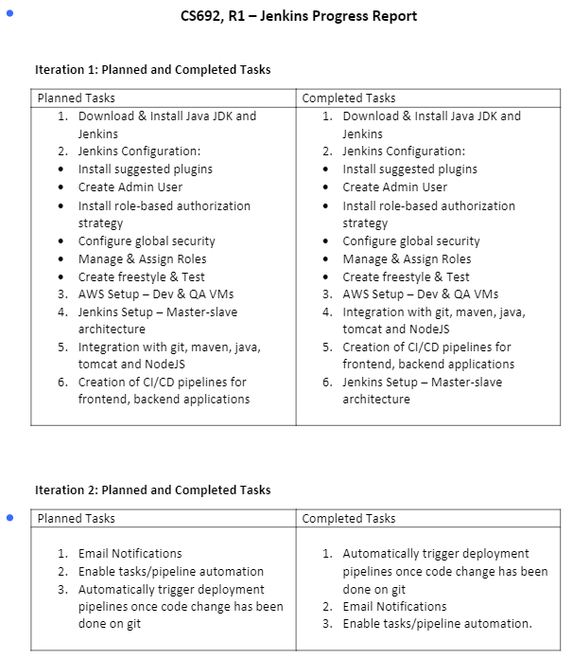
Jenkins progress report –Tarun dagar

Slide 25
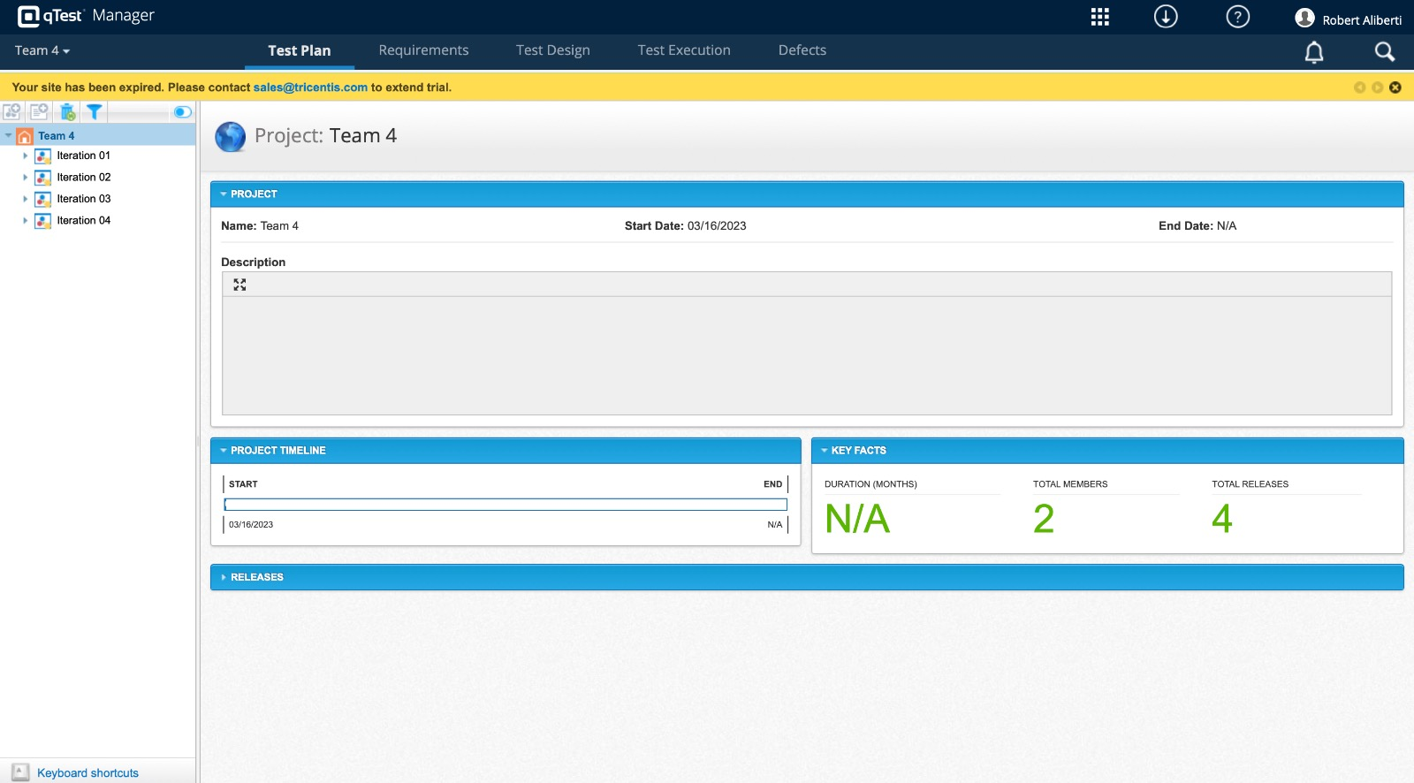
qtest

Slide 26
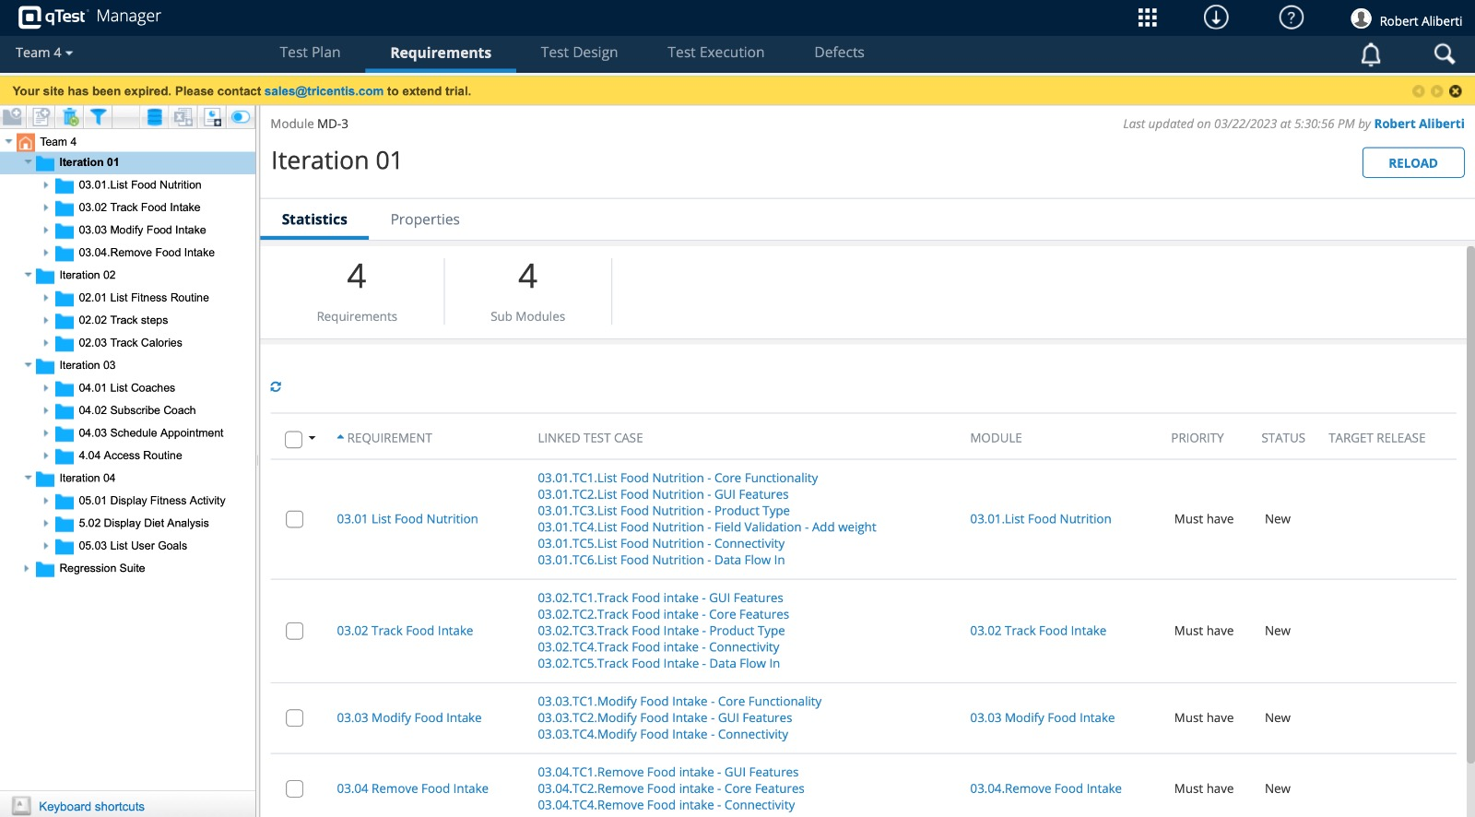

Slide 27
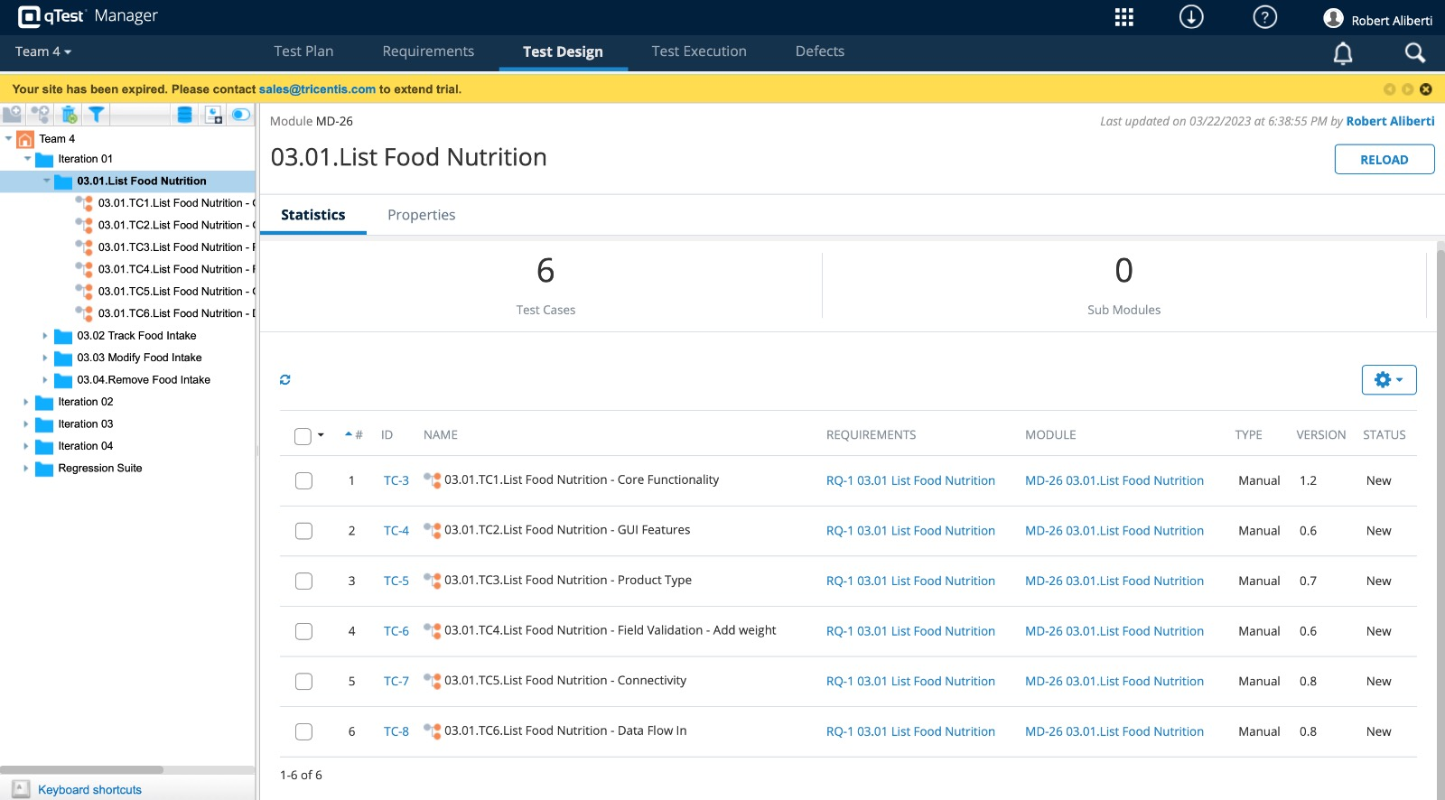

Slide 28
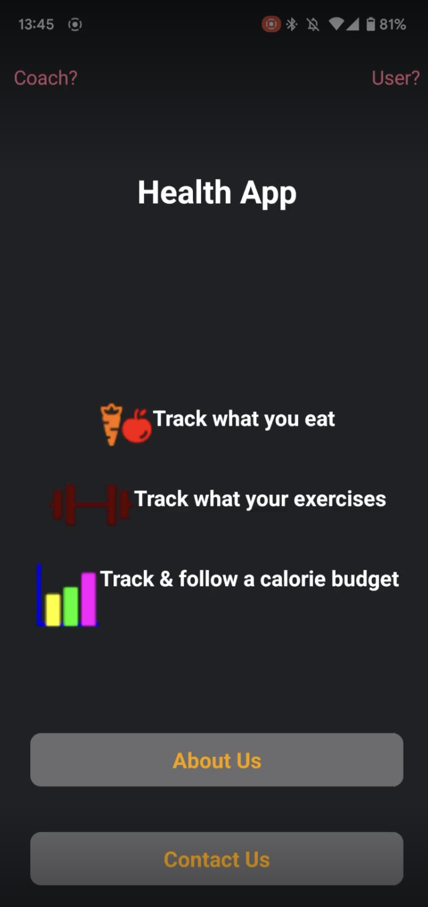
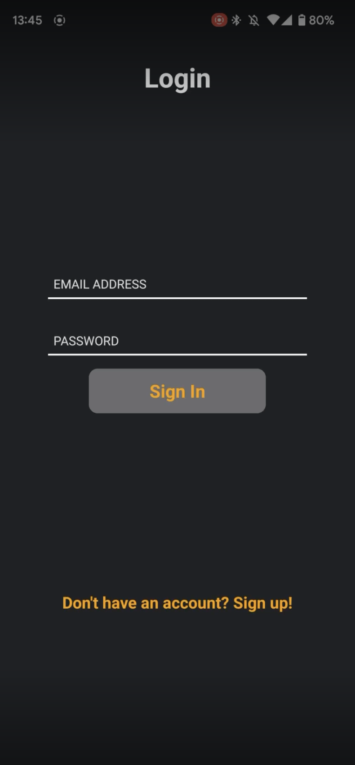
Application demo -sriharsha

Slide 29
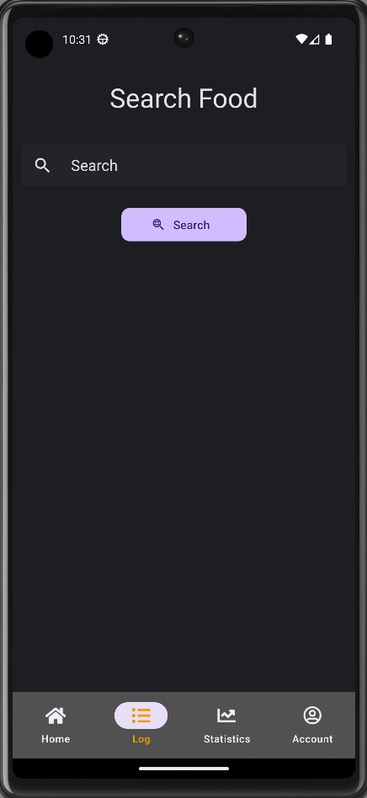
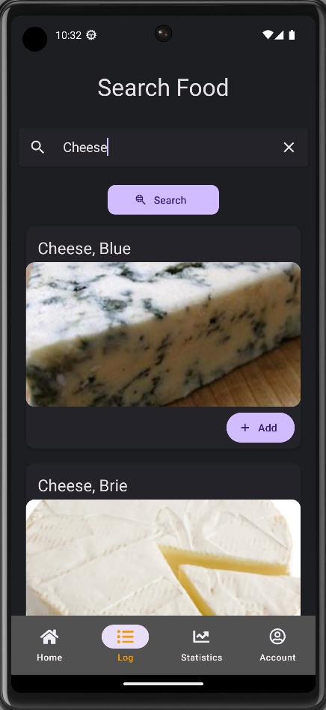

Slide 30
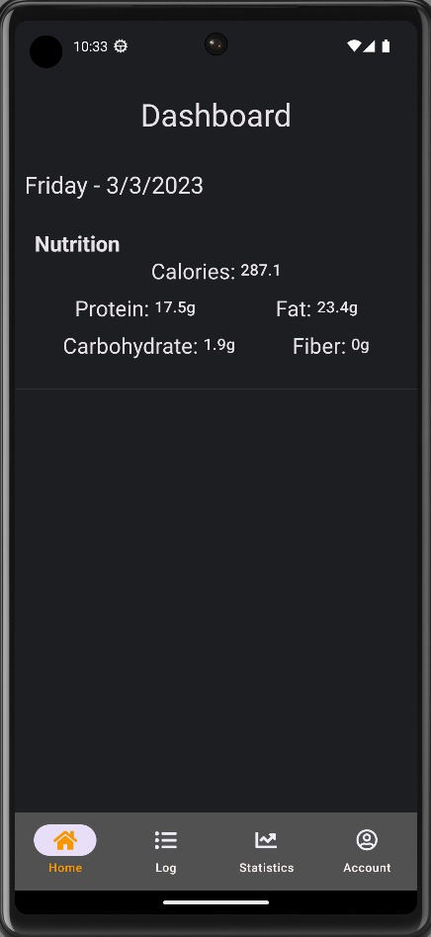
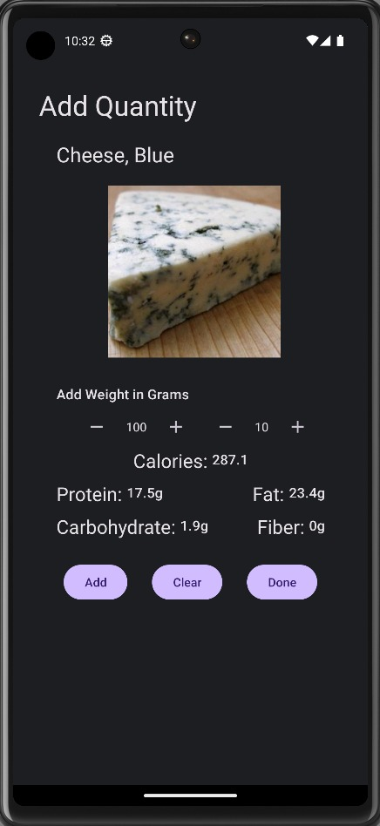

Slide 31
